Slide 1




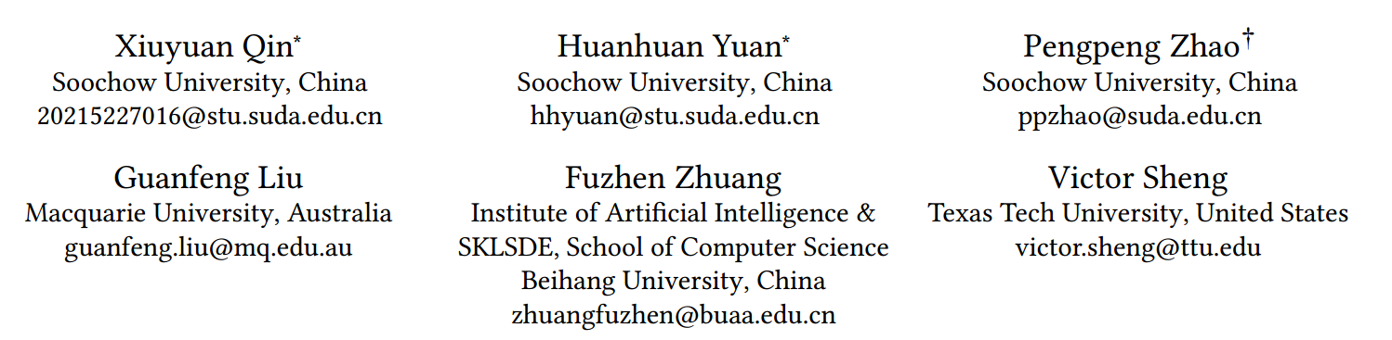





ATAI
Advanced Techniqueof Artificial Intelligence
ATAI
ChongqingUniversity _{AdvancedTechniqueof}
of Technology Artificial Intelligence
Chongqing University of
Technology
Chongqing University ^{ATAI}
_{of Technology} Advanced Techniqueof
Artificial Intelligence
Chongqing University of Technology
Chongqing University of Technology
  Intent Contrastive Learning with Cross Subsequences for
  Sequential Recommendation
Code: https://github.com/QinHsiu/ICSRec
2024.11.21•ChongQing
—— WSDM 2024
Reported by Shunan Yin
1

Slide 2

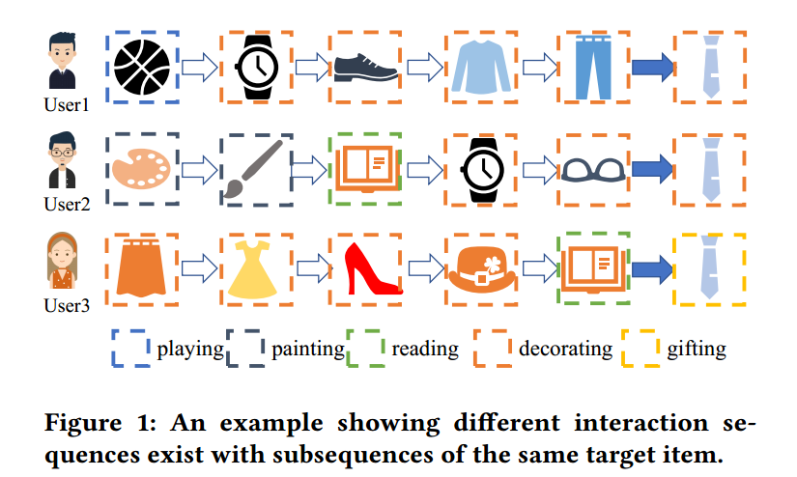
ATAI
AdvancedTechniqueof
Artificial Intelligence
ATAI
ChongqingUniversity _{AdvancedTechniqueof}
of Technology Artificial Intelligence
ChongqingUniversity of Technology
Motivation
(i). While the above attempts to construct contrastive learning tasks to learn the user’s intentions, they usually model each user interaction sequence individually and thus ignore the correlation between users with similar subsequence patterns.
(ii). The auxiliary information is sparse and not always available for recommender systems, and introducing stochastic data augmentation may introduce noise and thus change the intentions hidden in the sequence.

Slide 3

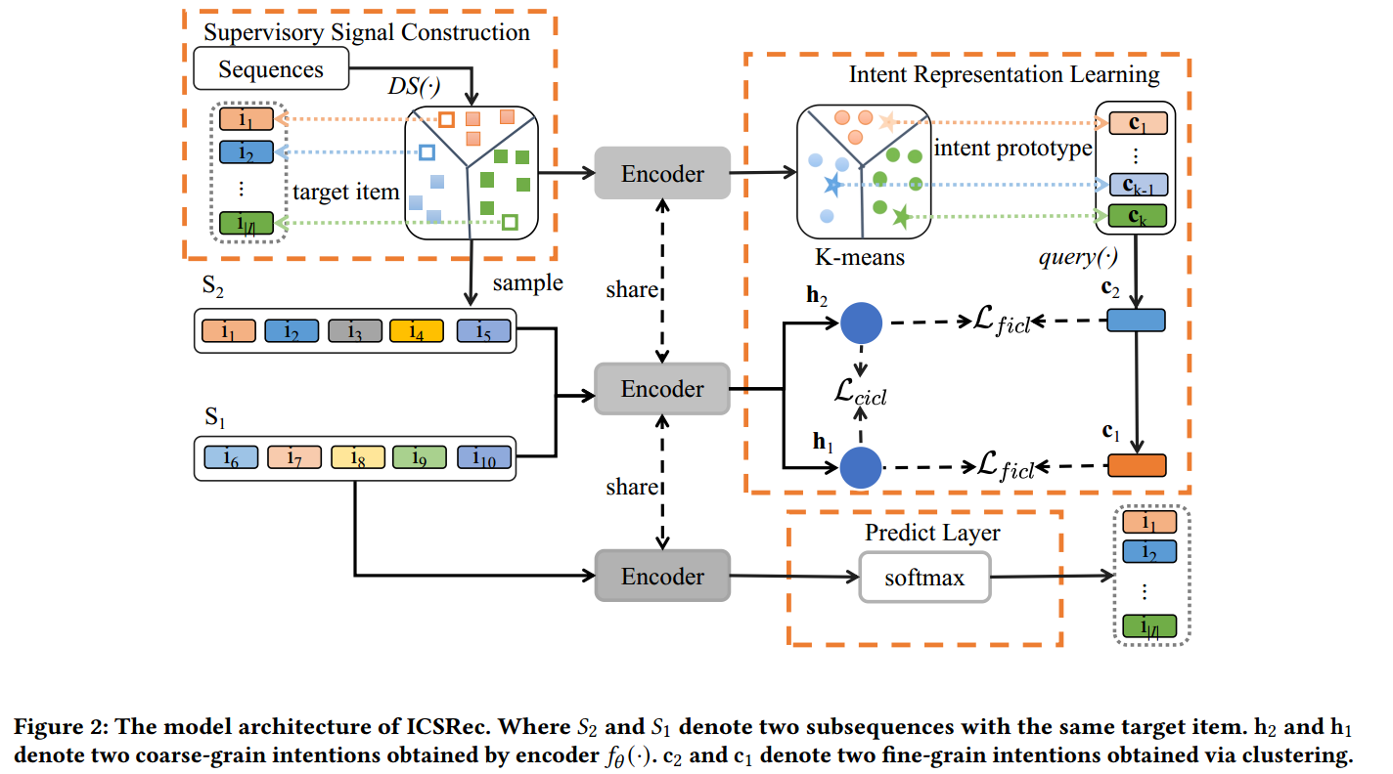
ChongqingUniversity of Technology
ATAI
AdvancedTechniqueof
Artificial Intelligence
ATAI
ChongqingUniversity _{AdvancedTechniqueof}
of Technology Artificial Intelligence
Overview

Slide 4

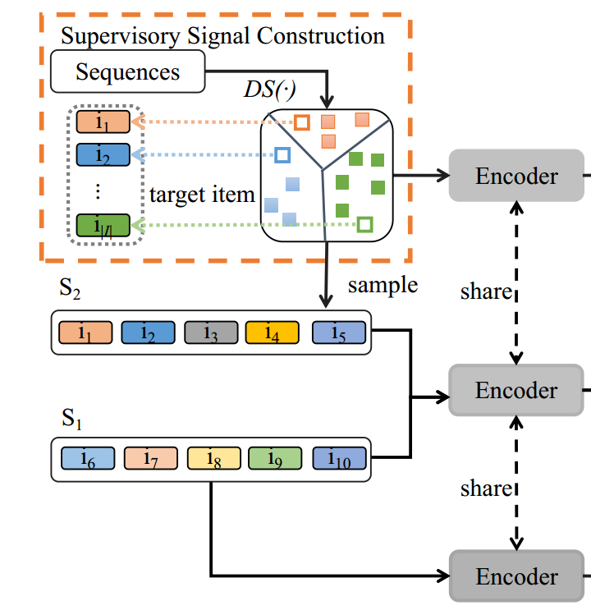

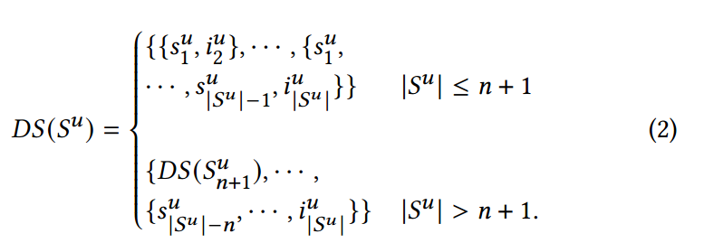
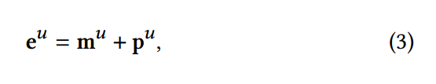
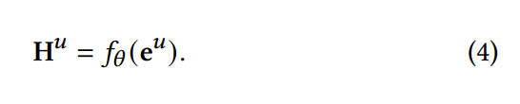
ChongqingUniversity of Technology
ATAI
AdvancedTechniqueof
Artificial Intelligence
ATAI
ChongqingUniversity _{AdvancedTechniqueof}
of Technology Artificial Intelligence
Method

Slide 5
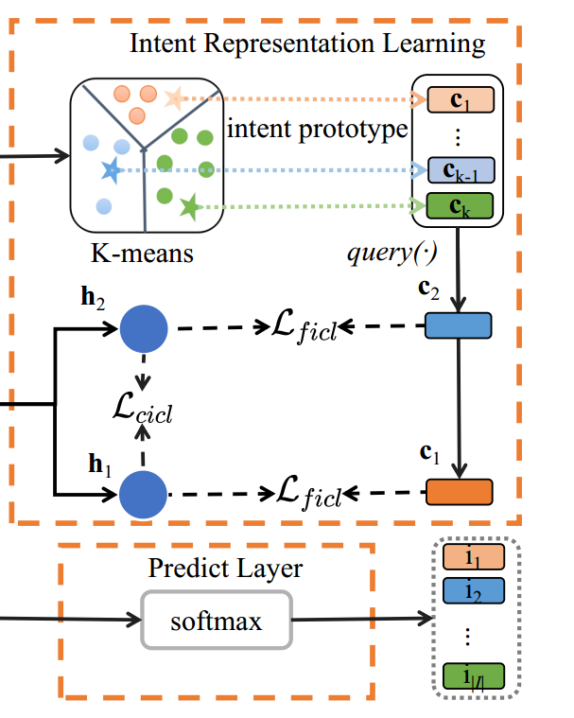

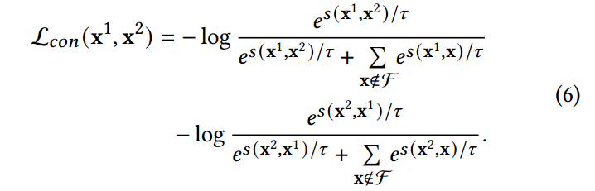


ChongqingUniversity of Technology
ATAI
AdvancedTechniqueof
Artificial Intelligence
ATAI
ChongqingUniversity _{AdvancedTechniqueof}
of Technology Artificial Intelligence
Method

Slide 6
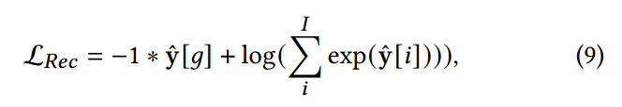


ChongqingUniversity of Technology
ATAI
AdvancedTechniqueof
Artificial Intelligence
ATAI
ChongqingUniversity _{AdvancedTechniqueof}
of Technology Artificial Intelligence
Method

Slide 7

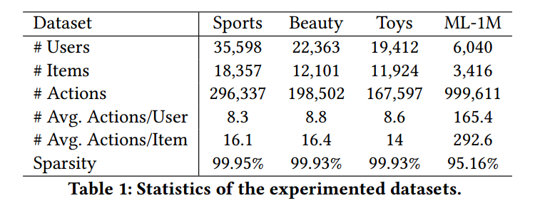
ATAI
AdvancedTechniqueof
Artificial Intelligence
ATAI
ChongqingUniversity _{AdvancedTechniqueof}
of Technology Artificial Intelligence
ChongqingUniversity of Technology
Experiments

Slide 8
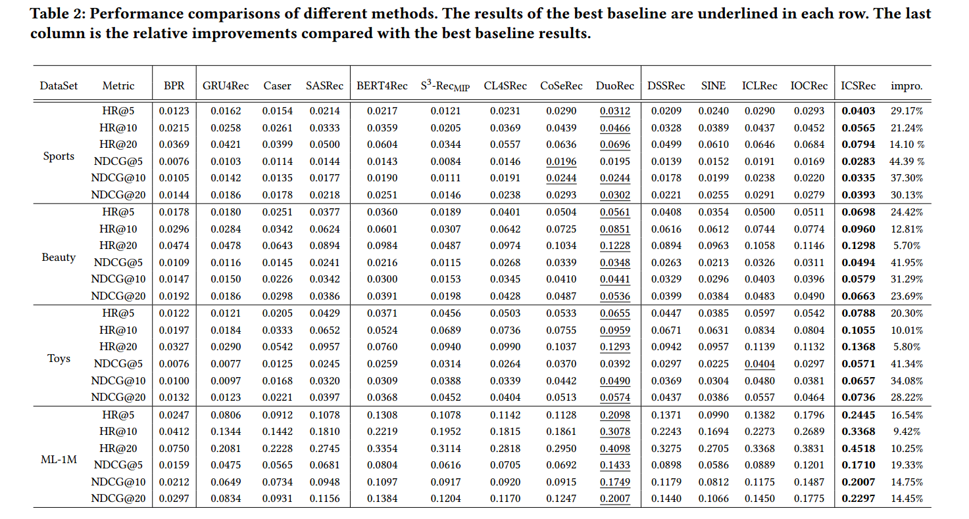
ATAI
AdvancedTechniqueof
Artificial Intelligence
ATAI
ChongqingUniversity _{AdvancedTechniqueof}
of Technology Artificial Intelligence
ChongqingUniversity of Technology
Experiments

Slide 9
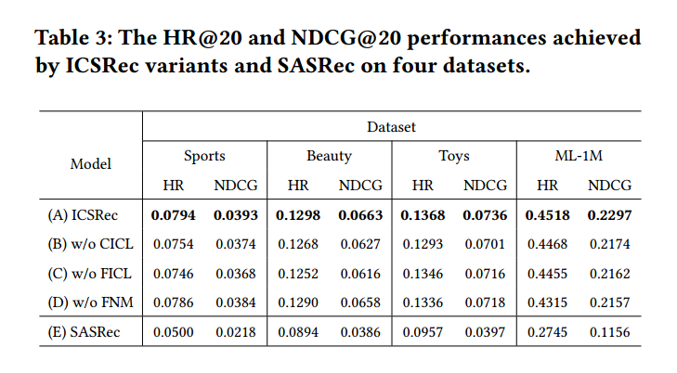
ATAI
AdvancedTechniqueof
Artificial Intelligence
ATAI
ChongqingUniversity _{AdvancedTechniqueof}
of Technology Artificial Intelligence
ChongqingUniversity of Technology
Experiments

Slide 10
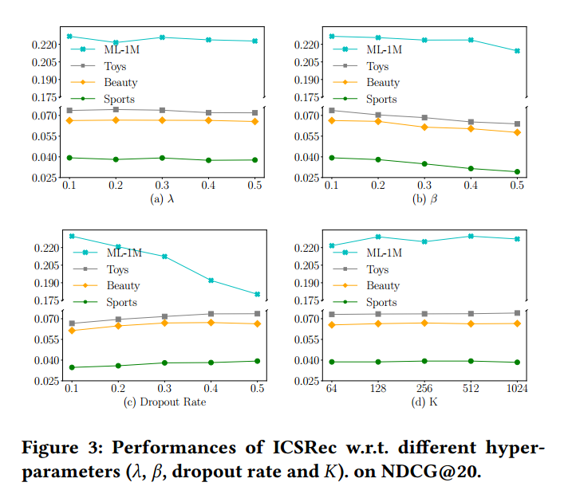
ATAI
AdvancedTechniqueof
Artificial Intelligence
ATAI
ChongqingUniversity _{AdvancedTechniqueof}
of Technology Artificial Intelligence
ChongqingUniversity of Technology
Experiments

Slide 11
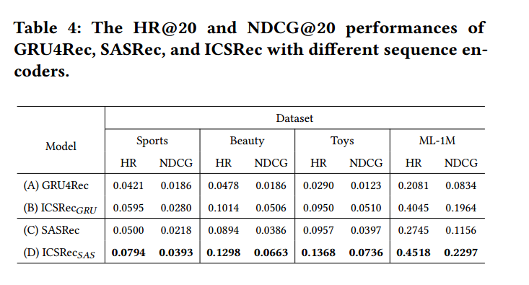
ATAI
AdvancedTechniqueof
Artificial Intelligence
ATAI
ChongqingUniversity _{AdvancedTechniqueof}
of Technology Artificial Intelligence
ChongqingUniversity of Technology
Experiments

Slide 12
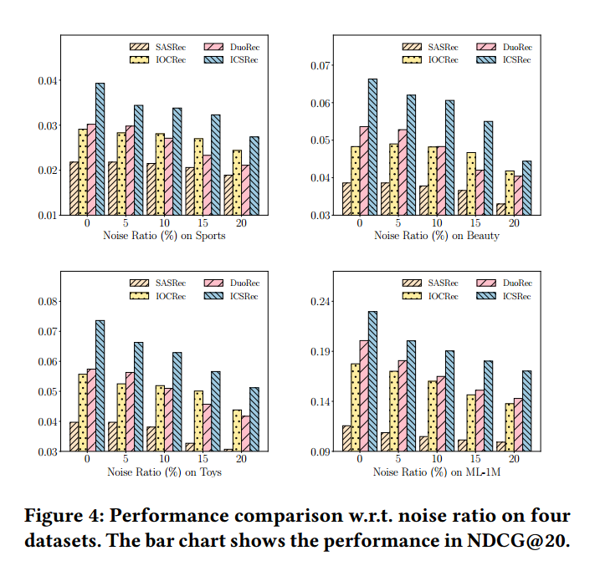
ATAI
AdvancedTechniqueof
Artificial Intelligence
ATAI
ChongqingUniversity _{AdvancedTechniqueof}
of Technology Artificial Intelligence
ChongqingUniversity of Technology
Experiments

Slide 13


ChongqingUniversity of Technology
ATAI
AdvancedTechniqueof
Artificial Intelligence
ATAI
ChongqingUniversity _{AdvancedTechniqueof}
of Technology Artificial Intelligence
Thanks!

